Slide 1
Digital marketing project Phase 2
Team ID :- LTvIP2023TMID10450
Team leader name : seedarapu sreeja
Team members:
v. Jayalakshmi
. I .sudharani
s . Rajeswari

Slide 2
Brand study competitor of Analysis &Buyer’s/Audience’s persona
Research Brand: Life insurance corporation of India
Mission/values: All Rights reserved-official website of Life insurance corporation of India
Usp: unique selling proposition (USP)
Analyze Brand Tone and Identify :life insurance corporation of India March 2022
Set 5 SM ART goals and kpls for the same:
:
The smart in smart goals stands for specific measurable , Achievable, relevant and time Bound..

Slide 3
Part1: Brand study competitor analysis &buyer’s Audience’s persona
Buyer’s/ Audience’s persona: 1 spontaneous Buyer
2 Methodical Buyer
3 Humanistic Buyer
4 Competitive Buyer

Slide 4
Part 1: brand study, competitor analysis & buyer’s/ audience’s Persona
Competitor 1: HDFC Life insurance co Ltd Headquarters. India. 32,448.&9. 7B.
Competitor 2 : ICIC prudential Life insurance co Ltd .
Competitor 3: Max life insurance co Ltd .

Slide 5
Part2: SEO& Keyword Research
SEO Audit: An SEO audit is the process of evaluating how well your website is optimized for search engines. A comprehensive SEO audit is critical for identifying opportunities for your SEO audit goals.
Keyword Research: Define Research objective . LIC premium payment online. LIC customer care .LIC online payment. LIC payment. LIC India. LIC plan .LIC online premium. LIC office in Gurgaon..

Slide 6
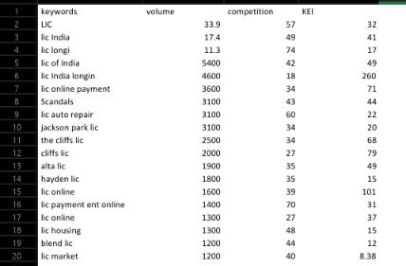

Slide 7
On page optimization: on page SEO(or on –site SEO is the practice of optimizing web page for specific keywords in order to improve Search visibility and traffic. It involves like title tags headings content and internal links with key words

Slide 8
Part3: Content Ideas and Marketing Strategies
Content Idea Generation & strategy: Content marketing example include media like newsletters . Podcasts social media poste and videos .
Example: All of these forms content are meant to provide useful and relevant information that delight users and attracts them to. Your brand Generations Of strategy of content Idea Generation….

Slide 9
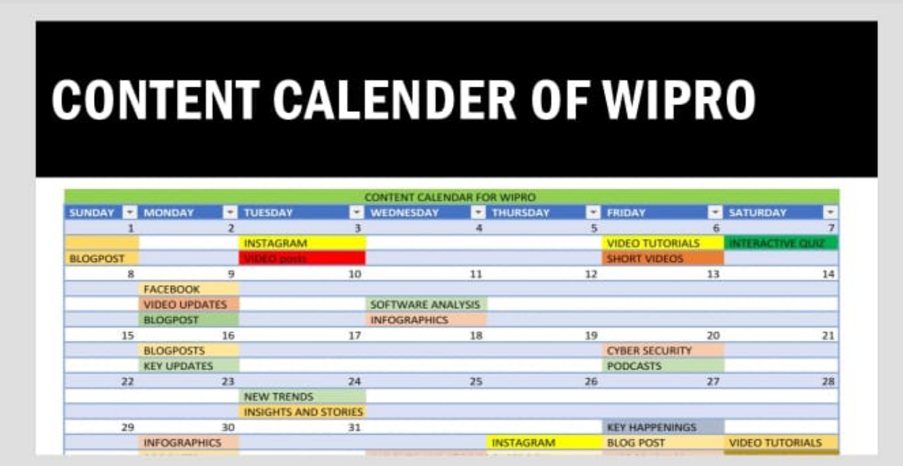

Slide 10
Part3: content Ideas and marketing strategies
Product price promotion place packaging position and people .An products marketing . Costumers and need change rapidly .you must continually. Results these seven PS to make maximum results possible for you in today marketplace..

Slide 11
Target audience
target Audient LIC mainly targets children basically
In to schooling. People in earning periods and senior citizens who have got retired from their respective Seriees.
Create a list of your contacts including family, friend , relatives and acquaintances and them approach them.

Slide 12

Part4: content creation and curation
Post Creation: posts in NACH master at NACH centrode zone . Whether intimation NACH center of the zone. Whether intimation LIC Validate the registration data and information the bank Provider about the creation….
Format1: The person legally entitled to receive the policy monies should give intimation of death of policy to the servicing Branch
Format2: Certified extract form death register .
Format3: Claims under Regular Life insurance policies..

Slide 13
Life Insurance Corporation of India (LIC) is an Indian multinational public sector life insurance company headquartered in Mumbai. It is India’s largest insurance company as well as the largest institutional investor with total assets under management worth ₹45.7 trillion (US$570 billion) as of March 2023.[3] It is under the ownership of Government of India and administrative control of the Ministry of Finance.

Slide 14
Part4: content creation and curation . Instagram story
https://instagram.com/stories/sasisasi1441/3212494916165363003?igshid=NjZiM2M3MzIxNA==
https://www.instagram.com/s/aGlnaGxpZ2h0OjE4MDYzMDY4MjIxNDUyNzE1?story_media_id=3212494916165363003_49755919752&igshid=NTc4MTIwNjQ2YQ==
https://instagram.com/sasisasi1441?igshid=ZGUzMzM3NWJiOQ==

Slide 15
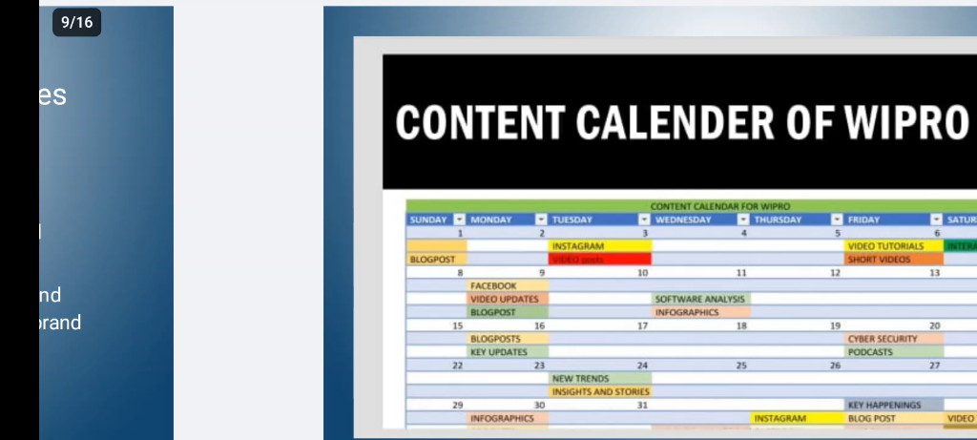
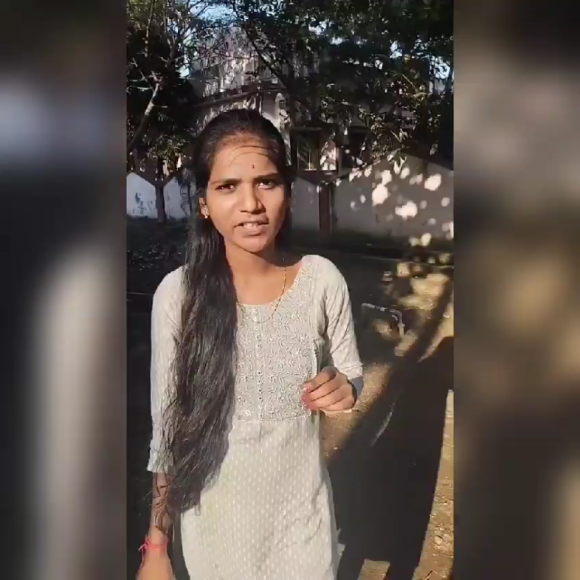
Part 4: content creation and curation
Designs/video editing

